Slide 1
Chapter 2
Computer-Based System Engineering

Slide 2
Systems Engineering
Designing, implementing, deploying and operating systems which include hardware, software and people

Slide 3
Objectives
To explain why system software is affected by broader system engineering issues
To introduce the concept of emergent system properties such as reliability and security
To explain why the systems environment must be considered in the system design process
To explain system engineering and system procurement processes

Slide 4
Topics covered
Emergent system properties
Systems and their environment
System modelling
The system engineering process
System procurement

Slide 5
What is a system?
A purposeful collection of inter-related components working together towards some common objective.
A system may include software, mechanical, electrical and electronic hardware and be operated by people.
System components are dependent on other
system components
The properties and behaviour of system components are inextricably inter-mingled

Slide 6
Problems of systems engineering
Large systems are usually designed to solve
'wicked' problems
Systems engineering requires a great deal of
co-ordination across disciplines
  Almost infinite possibilities for design trade-offs across
  components
  Mutual distrust and lack of understanding across engineering disciplines
Systems must be designed to last many years
in a changing environment

Slide 7
Software and systems engineering
The proportion of software in systems is increasing. Software-driven general purpose electronics is replacing special-purpose systems
Problems of systems engineering are similar to
problems of software engineering
Software is (unfortunately) seen as a problem
in systems engineering. Many large system projects have been delayed because of software problems

Slide 8
Emergent properties
Properties of the system as a whole rather than properties that can be derived from the properties of components of a system
Emergent properties are a consequence of the relationships between system components
They can therefore only be assessed and measured once the components have been integrated into a system

Slide 9
Examples of emergent properties
The overall weight of the system
  This is an example of an emergent property that can be computed from individual component properties.
The reliability of the system
  This depends on the reliability of system components and the relationships between the components.
The usability of a system
  This is a complex property which is not simply dependent on the system hardware and software but also depends on the system operators and the environment where it is used.

Slide 10
Types of emergent property
Functional properties
  These appear when all the parts of a system work together to achieve some objective. For example, a bicycle has the functional property of being a transportation device once it has been assembled from its components.
Non-functional emergent properties
  Examples are reliability, performance, safety, and security. These relate to the behaviour of the system in its operational environment. They are often critical for computer-based systems as failure to achieve some minimal defined level in these properties may make the system unusable.

Slide 11
System reliability engineering
Because of component inter-dependencies,
faults can be propagated through the system
System failures often occur because of
unforeseen inter-relationships between
components
It is probably impossible to anticipate all
possible component relationships
Software reliability measures may give a false
picture of the system reliability

Slide 12
Influences on reliability
Hardware reliability
  What is the probability of a hardware component failing and how long does it take to repair that component?
Software reliability
  How likely is it that a software component will produce an incorrect output. Software failure is usually distinct from hardware failure in that software does not wear out.
Operator reliability
  How likely is it that the operator of a system will make an error?

Slide 13
Reliability relationships
Hardware failure can generate spurious signals that are outside the range of inputs expected by the software
Software errors can cause alarms to be activated which cause operator stress and lead to operator errors
The environment in which a system is installed can affect its reliability

Slide 14
The ‘shall-not’ properties
Properties such as performance and reliability can be measured
However, some properties are properties that the system should not exhibit
  Safety - the system should not behave in an unsafe way
  Security - the system should not permit unauthorised use
Measuring or assessing these properties is very hard

Slide 15
Systems and their environment
Systems are not independent but exist in an environment
System’s function may be to change its environment
Environment affects the functioning of the system e.g. system may require electrical supply from its environment
The organizational as well as the physical environment may be important

Slide 16
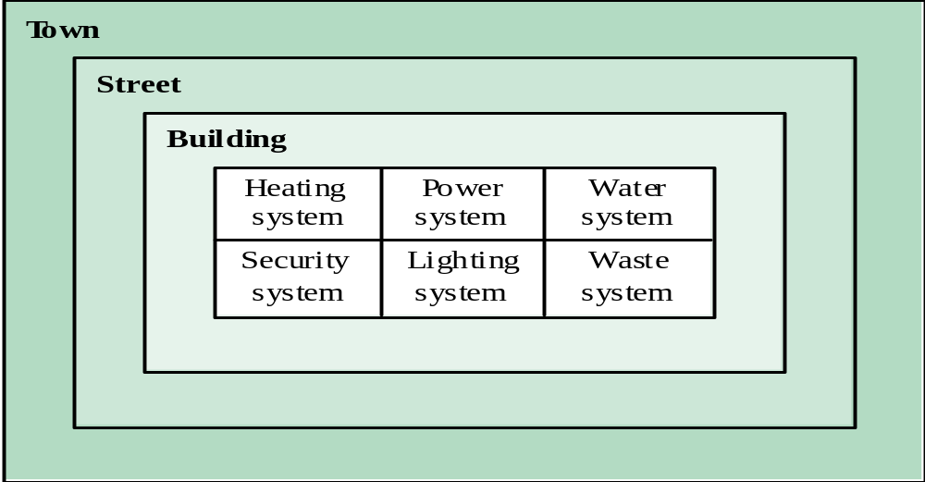
System hierarchies

Slide 17
Human and organisational factors
Process changes
  Does the system require changes to the work processes in the environment?
Job changes
  Does the system de-skill the users in an environment or cause them to change the way they work?
Organisational changes
  Does the system change the political power structure in an organisation?

Slide 18
System architecture modelling
An architectural model presents an abstract view of the sub-systems making up a system
May include major information flows between sub-systems
Usually presented as a block diagram
May identify different types of functional component in the model

Slide 19
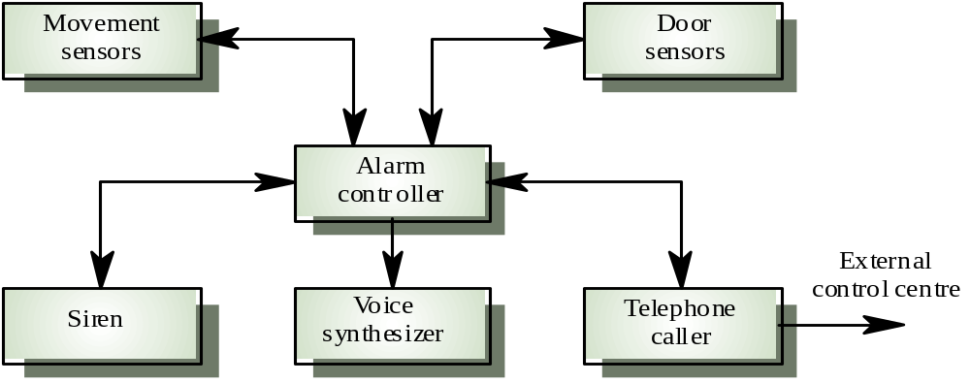
Intruder alarm system

Slide 20
Component types in alarm system
Sensor
  Movement sensor, door sensor
Actuator
  Siren
Communication
  Telephone caller
Co-ordination
  Alarm controller
Interface
  Voice synthesizer

Slide 21
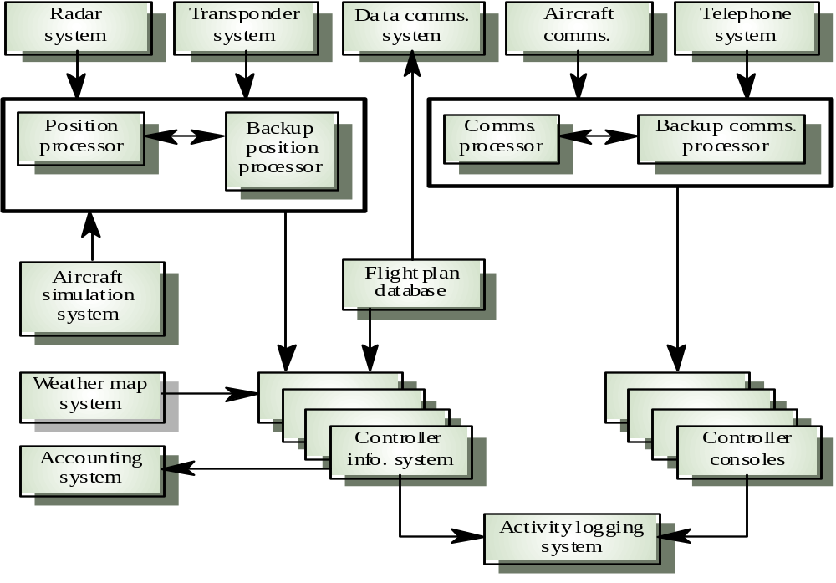
ATC system
architecture
©Ian Sommerville2000 Software Engineering, 5th edition. Chapter 02 Slide21

Slide 22
Functional system components
Sensor components
Actuator components
Computation components
Communication components
Co-ordination components
Interface components

Slide 23
System components
Sensor components
  Collect information from the system’s environment e.g. radars in an air traffic control system
Actuator components
  Cause some change in the system’s environment e.g. valves in a process control system which increase or decrease material flow in a pipe
Computation components
  Carry out some computations on an input to produce an output e.g. a floating point processor in a computer system

Slide 24
System components
Communication components
  Allow system components to communicate with each other e.g. network linking distributed computers
Co-ordination components
  Co-ordinate the interactions of other system components e.g. scheduler in a real-time system
Interface components
  Facilitate the interactions of other system components e.g. operator interface
All components are now usually software controlled

Slide 25
Component types in alarm system
Sensor
  Movement sensor, Door sensor
Actuator
  Siren
Communication
  Telephone caller
Coordination
  Alarm controller
Interface
  Voice synthesizer

Slide 26
The system engineering process
Usually follows a ‘waterfall’ model because of the need for parallel development of different parts of the system
  Little scope for iteration between phases because hardware changes are very expensive. Software may have to compensate for hardware problems
Inevitably involves engineers from different disciplines who must work together
  Much scope for misunderstanding here. Different disciplines use a different vocabulary and much negotiation is required. Engineers may have personal agendas to fulfil

Slide 27
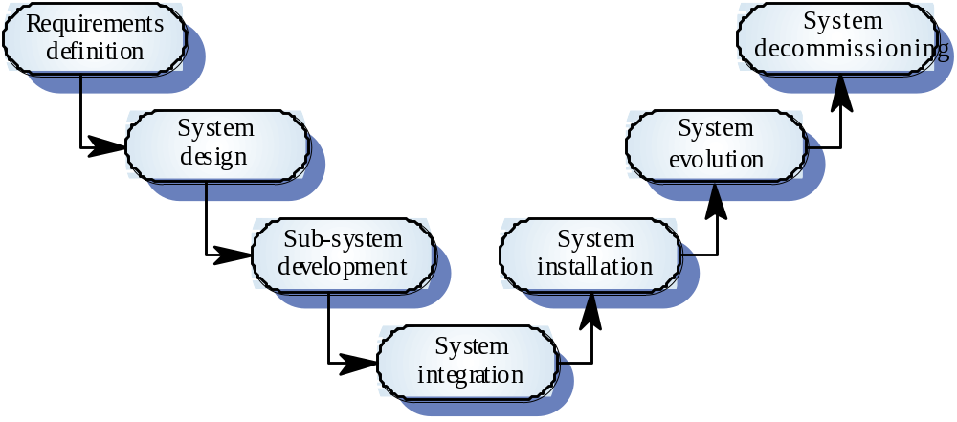
The system engineering process

Slide 28
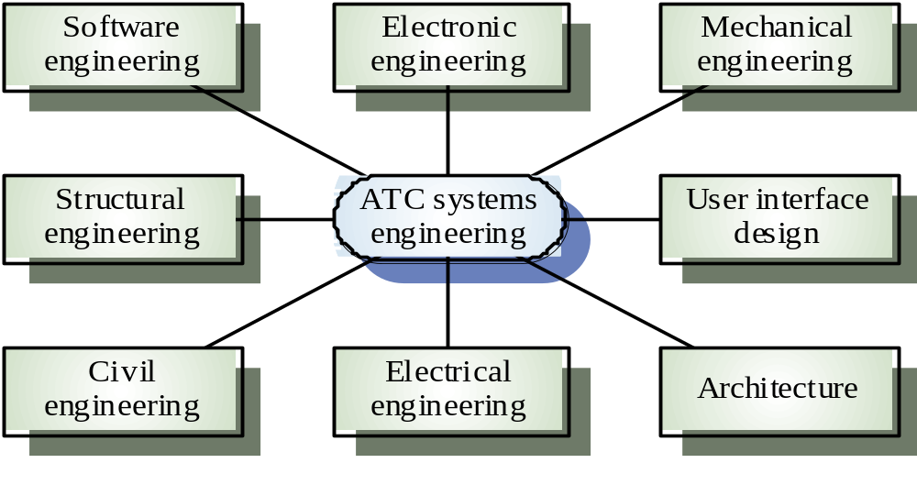
Inter-disciplinary involvement

Slide 29
System requirements definition
Three types of requirement defined at this stage
  Abstract functional requirements. System functions are defined in an abstract way
  System properties. Non-functional requirements for the system in general are defined
  Undesirable characteristics. Unacceptable system behaviour is specified
Should also define overall organisational objectives for the system

Slide 30
System objectives
Functional objectives
  To provide a fire and intruder alarm system for the building which will provide internal and external warning of fire or unauthorized intrusion
Organisational objectives
  To ensure that the normal functioning of work carried out in the building is not seriously disrupted by events such as fire and unauthorized intrusion

Slide 31
System requirements problems
Changing as the system is being specified
Must anticipate hardware/communications
developments over the lifetime of the system
Hard to define non-functional requirements
(particularly) without an impression of
component structure of the system.

Slide 32
The system design process
Partition requirements
  Organise requirements into related groups
Identify sub-systems
  Identify a set of sub-systems which collectively can meet the system requirements
Assign requirements to sub-systems
  Causes particular problems when COTS are integrated
Specify sub-system functionality
Define sub-system interfaces
  Critical activity for parallel sub-system development

Slide 33
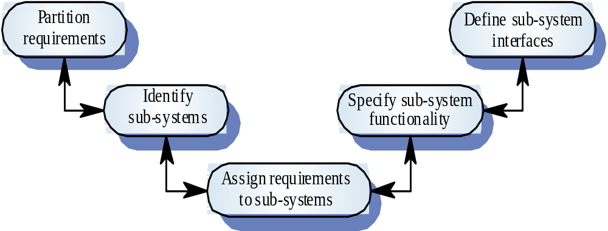
The system design process

Slide 34
System design problems
Requirements partitioning to hardware,
software and human components may involve a lot of negotiation
Difficult design problems are often assumed to be readily solved using software
Hardware platforms may be inappropriate for
software requirements so software must compensate for this

Slide 35
Sub-system development
Typically parallel projects developing the
hardware, software and communications
May involve some COTS (Commercial Off-the-Shelf) systems procurement
Lack of communication across implementation
teams
Bureaucratic and slow mechanism for
proposing system changes means that the development schedule may be extended because of the need for rework

Slide 36
System integration
The process of putting hardware, software and
people together to make a system
Should be tackled incrementally so that sub-systems are integrated one at a time
Interface problems between sub-systems are usually found at this stage
May be problems with uncoordinated deliveries
of system components

Slide 37
System installation
Environmental assumptions may be incorrect
May be human resistance to the introduction of
a new system
System may have to coexist with alternative
systems for some time
May be physical installation problems (e.g.
cabling problems)
Operator training has to be identified

Slide 38
System operation
Will bring unforeseen requirements to light
Users may use the system in a way which is
not anticipated by system designers
May reveal problems in the interaction with
other systems
  Physical problems of incompatibility
  Data conversion problems
  Increased operator error rate because of inconsistent interfaces

Slide 39
System evolution
Large systems have a long lifetime. They must evolve to meet changing requirements
Evolution is inherently costly
  Changes must be analysed from a technical and business perspective
  Sub-systems interact so unanticipated problems can arise
  There is rarely a rationale for original design decisions
  System structure is corrupted as changes are made to it
Existing systems which must be maintained are sometimes called legacy systems

Slide 40
System decommissioning
Taking the system out of service after its useful lifetime
May require removal of materials (e.g. dangerous chemicals) which pollute the environment
  Should be planned for in the system design by encapsulation
May require data to be restructured and converted to be used in some other system

Slide 41
System procurement
Acquiring a system for an organization to meet some need
Some system specification and architectural design is usually necessary before procurement
  You need a specification to let a contract for system development
  The specification may allow you to buy a commercial off-the-shelf (COTS) system. Almost always cheaper than developing a system from scratch

Slide 42
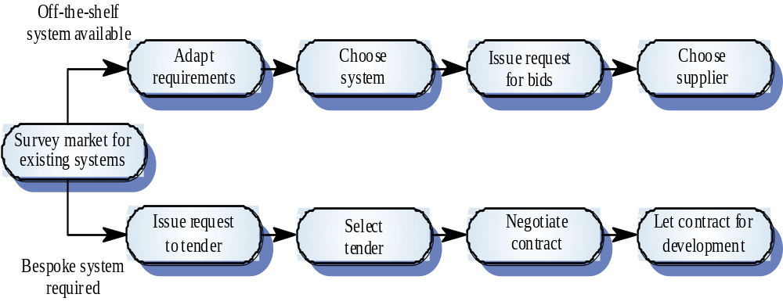
The system procurement process

Slide 43
Procurement issues
Requirements may have to be modified to match the capabilities of off-the-shelf components
The requirements specification may be part of the contract for the development of the system
There is usually a contract negotiation period to agree changes after the contractor to build a system has been selected

Slide 44
Contractors and sub-contractors
The procurement of large hardware/software systems is usually based around some principal contractor
Sub-contracts are issued to other suppliers to supply parts of the system
Customer liases with the principal contractor and does not deal directly with sub-contractors

Slide 45
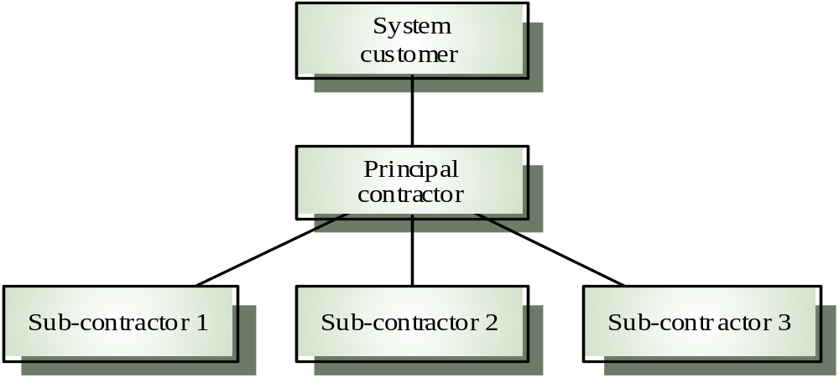
Contractor/Sub-contractor model

Slide 46
Key points
System engineering involves input from a range of disciplines
Emergent properties are properties that are characteristic of the system as a whole and not its component parts
System architectural models show major sub-systems and inter-connections. They are usually described using block diagrams

Slide 47
Key points
System component types are sensor, actuator, computation, co-ordination, communication and interface
The systems engineering process is usually a waterfall model and includes specification, design, development and integration.
System procurement is concerned with deciding which system to buy and who to buy it from

Slide 48
Conclusion
Systems engineering is hard! There will never be an easy answer to the problems of complex system development
Software engineers do not have all the answers
but may be better at taking a systems
viewpoint
Disciplines need to recognise each others
strengths and actively rather than reluctantly
cooperate in the systems engineering process

